Slide 1
MongoDB
Advanced

Slide 2
Agenda
Day 1
MongoDB basics Recap
Configure Local MongoDB
MongoDB Atlas overview
Create MongoDB cluster with Atlas
Advanced Querying Techniques
Indexing Strategies
Schema Design and Data Modeling
Performance Tuning and Optimization
Replication and High Availability
Replication with Community edition
Day 2
Scalability
Sharding for horizontal scalability
Security considerations
Data encryption
Access management
Auditing
Backups and recovery
Data Migration and Import/Export
Monitoring and Performance Optimization
Atlas Search, Atlas Data Sync.

Slide 3
Training Format
Concepts
Hands-on exercises
Challenge/Assignments 15 to 20 min
Interactive

Slide 4
Timing
Start time at 9.30 am IST
Break 1 - 11 am
Lunch - 1pm to 2pm
Break 2 - 3 pm
End at 4.30 am

Slide 5
Infra setup
MongoDB Community Edition
VS Code
Mongo Compose
MongoDB Atlas

Slide 6
MongoDB basics Recap
Document-Oriented:
MongoDB is a NoSQL database that stores data in flexible, JSON-like documents, allowing for varied data structures.
Schema-less:
Collections in MongoDB do not enforce document structure, providing flexibility in data modeling and storage.
Scalability:
MongoDB supports horizontal scaling through sharding, allowing the distribution of data across multiple servers.

Slide 7
MongoDB basics Recap
High Performance:
Optimized for read and write operations, MongoDB offers high performance for large-scale applications.
Indexing:
Supports a variety of indexing techniques, including single field, compound, geospatial, and full-text indexes, to improve query performance.
Aggregation Framework:
Provides powerful tools for data processing and transformation through pipelines, enabling complex queries and analytics.

Slide 8
MongoDB basics Recap
Replication:
Ensures high availability and data redundancy with replica sets, which provide automatic failover and data recovery.
Community and Ecosystem:
Rich ecosystem with strong community support, numerous libraries, and integrations for various programming languages and platforms.

Slide 9
Ecosystem
MongoDB Community
MongoDB Compass
MongoDB Atlas

Slide 10
Install MongoDB
https://docs.google.com/document/d/1Xo6R21Zja9_2jrNhJ4Q2CRzvLLZ3dq4xNe5GQKy2Erc/edit?usp=sharing

Slide 11
CRUD Operations in MongoDB using Mongo Shell
db.users.insertOne({ name: "Alice", age: 25 })
db.users.insertMany([{ name: "Bob", age: 30 }, { name: "Charlie", age: 35 }])
db.users.find({ age: { $gt: 25 } }) // Find all users older than 25
db.users.findOne({ name: "Alice" }) // Find a user named Alice

Slide 12
CRUD Operations in MongoDB using Mongo Shell
db.users.updateOne({ name: "Alice" }, { $set: { age: 26 } }) // Update Alice's age to 26
db.users.updateMany({ age: { $gt: 25 } }, { $set: { status: "active" } }) // Update status to active for users older than 25
db.users.deleteOne({ name: "Alice" }) // Delete the user named Alice
db.users.deleteMany({ age: { $lt: 30 } }) // Delete all users younger than 30

Slide 13
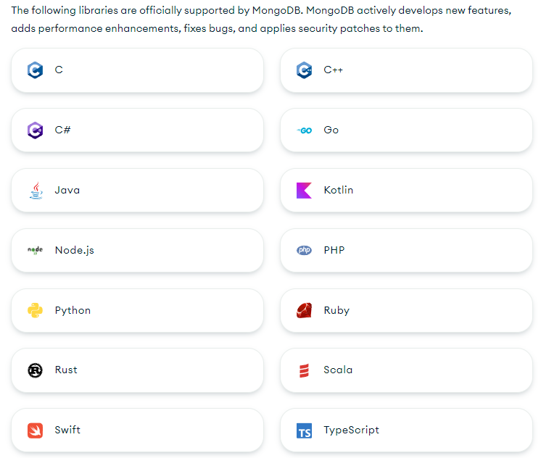
Developing with MongoDB
You can connect your application to your MongoDB Atlas deployment or a self-hosted MongoDB cluster by using one of the official MongoDB libraries.
https://www.mongodb.com/docs/languages/python/

Slide 14
from pymongo import MongoClient
# connect to mongodb
client = MongoClient("mongodb://localhost:27017/")
db = client["arjun-pymongo-db"]
collection = db["arjuncollection"]
collection.insert_one({"name": "arjun", "age": 30})
result = collection.find_one({"name": "arjun"})
print(result)

Slide 15
Self-Hosting MongoDB comes with its own set of challenges:
Scalability:
As your data grows, you may need to shard your database, which adds complexity in terms of managing multiple servers and ensuring data consistency.
Performance Tuning:
MongoDB requires ongoing performance tuning, including indexing, query optimization, and proper schema design to avoid slow queries and ensure efficient data access.
Backup and Recovery:
Implementing reliable backup and recovery processes is crucial. You need to ensure that your backups are consistent and can be restored quickly in case of data loss or corruption.

Slide 16
Self-Hosting MongoDB comes with its own set of challenges:
Security:
Securing your MongoDB instance is essential. This involves setting up authentication, authorization, encryption, and regularly updating to patch security vulnerabilities.
High Availability:
To ensure your MongoDB instance is highly available, you need to configure replica sets, which require careful setup and monitoring to handle failover and redundancy.
Monitoring and Maintenance:
Continuous monitoring of your MongoDB instance for performance issues, resource usage, and potential failures is necessary. This involves using monitoring tools and setting up alerts for critical issues.

Slide 17
Self-Hosting MongoDB comes with its own set of challenges:
Resource Management:
MongoDB can be resource-intensive, requiring significant CPU, memory, and disk I/O. You need to provision adequate hardware resources and plan for scaling as your workload increases.
Complex Upgrades:
Upgrading MongoDB versions can be complex and may require downtime. Careful planning and testing are needed to ensure a smooth upgrade process without data loss or disruption.
Network Configuration:
Proper network configuration is needed to ensure efficient communication between MongoDB nodes, including handling latency, bandwidth, and network security.
Data Migration:
If you're migrating data from another database to MongoDB, you may face challenges with data transformation, schema design, and ensuring data integrity during the migration process.

Slide 18
MongoDB Atlas overview
The most advanced cloud database service on the market, with unmatched data distribution and mobility across AWS, Azure, and Google Cloud, built-in automation for resource and workload optimization, and so much more.
MongoDB Atlas is an integrated suite of data services centered around a cloud database designed to accelerate and simplify how you build with data.
Build faster and build smarter with a developer data platform that helps solve your data challenges.

Slide 19
MongoDB Atlas overview
MongoDB Atlas is a fully managed cloud database service provided by MongoDB, Inc.
It simplifies database operations by automating deployment, scaling, and maintenance tasks, allowing developers to focus on building applications rather than managing infrastructure.
MongoDB Atlas provides a powerful, secure, and scalable platform for modern applications, making it easier for developers to manage databases and focus on innovation.

Slide 20
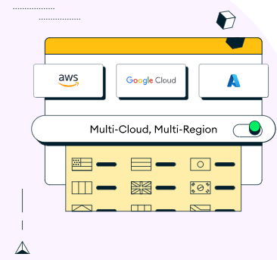
Features and benefits
Fully Managed Service
Automates provisioning, patching, and updates.
Reduces operational overhead and complexity.
Global Distribution
Deploy databases across multiple regions and cloud providers (AWS, Azure, Google Cloud).
Ensures low-latency access and high availability.

Slide 21
Features and benefits
Scalability and Performance
Easily scale storage and compute resources vertically and horizontally.
Supports sharding to distribute data across multiple nodes for high performance.
Robust Security
End-to-end encryption (in-transit and at-rest).
Fine-grained access controls, IP whitelisting, and VPC peering.

Slide 22
Features and benefits
Comprehensive Monitoring and Alerts
Real-time performance metrics and monitoring dashboards.
Customizable alerts for proactive management.
Automated Backup and Restore
Continuous backups with point-in-time recovery.
Easy management of snapshots and restores.

Slide 23
Features and benefits
Data Migration and Import
Tools and services to facilitate migration from existing MongoDB deployments.
Supports importing and exporting data using various formats.
Serverless Instances
Flexible, cost-effective serverless instances that automatically scale based on workload.

Slide 24
Features and benefits
Developer-Friendly
Compatible with a wide range of programming languages and frameworks.
Provides comprehensive APIs and SDKs for seamless integration.
Compliance and Certifications
Meets industry standards and compliance requirements such as GDPR, HIPAA, SOC 2, and more.
24/7 Support
Access to expert support and a large, active community for assistance and best practices.

Slide 25
Atlas overview
https://www.mongodb.com/

Slide 26
Create MongoDB Cluster
https://account.mongodb.com/account/login
Sign Up or Log In: First, you need to sign up for a MongoDB Atlas account or log in if you already have one.
Create a New Project: Once logged in, create a new project by clicking on "New Project." Give your project a name and add any necessary team members.
Build a New Cluster: Inside your project, click on the "Build a New Cluster" button. This will take you to the cluster creation wizard.
Choose Cloud Provider and Region: Select the cloud provider (AWS, Google Cloud, or Azure) and the region where you want to deploy your cluster. Consider data residency requirements and latency for your application's users when choosing a region.
Cluster Tier and Configuration:
Cluster Tier: Select the tier that matches your needs. Atlas offers different tiers ranging from free (M0) to high-performance dedicated clusters.
Cluster Name: Give your cluster a name.
Configuration Options: You can customize various settings, including the number of nodes (replica set or sharded cluster), instance size, and storage options. For a production environment, choose a configuration that meets your performance and reliability requirements.
Additional Settings: You can configure backup options, security settings, and other advanced configurations if needed.
Create Cluster: Once you've configured your cluster, click on "Create Cluster." The creation process may take a few minutes.

Slide 27
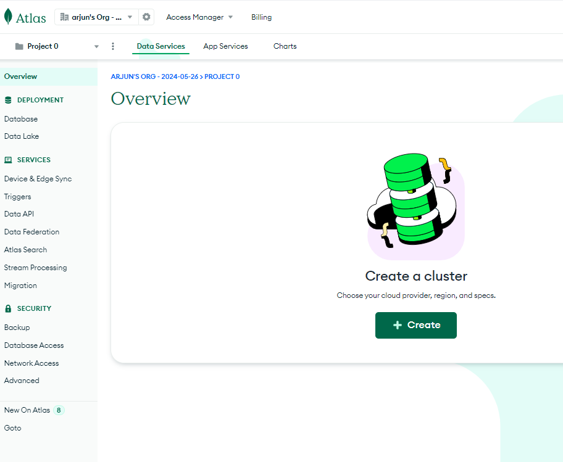

Slide 28
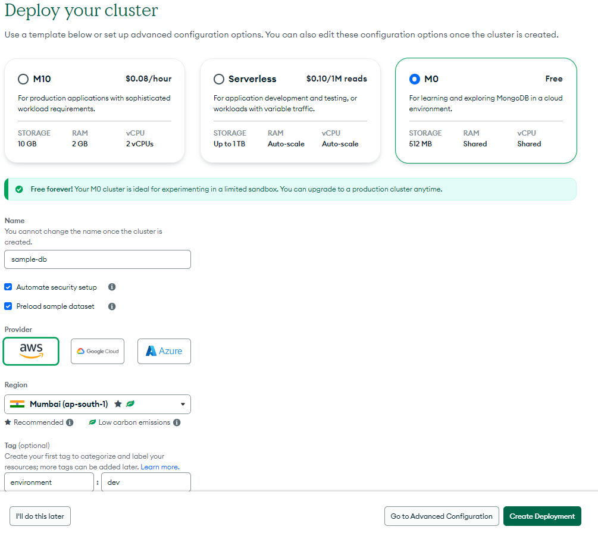

Slide 29
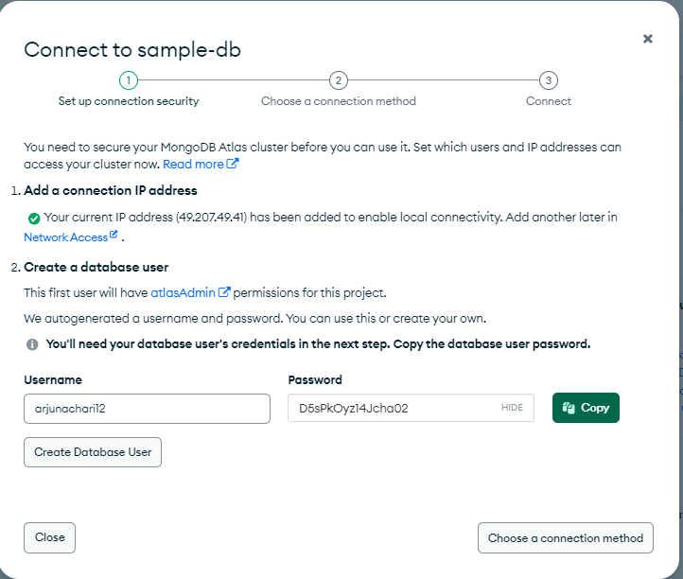

Slide 30
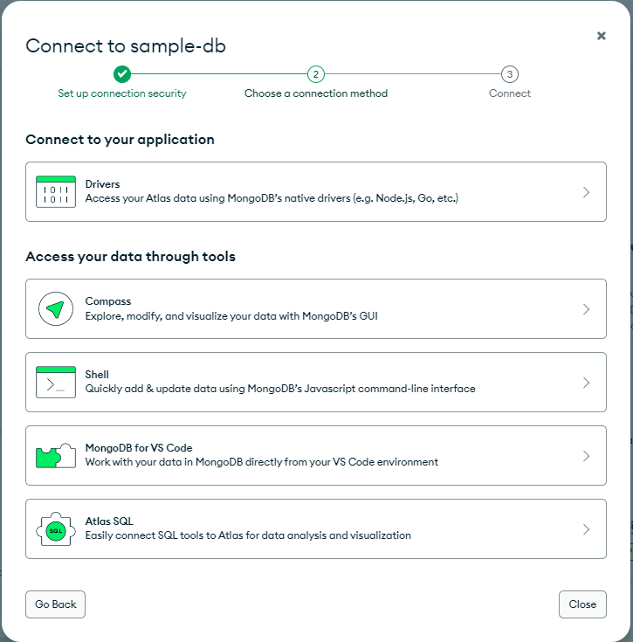

Slide 31
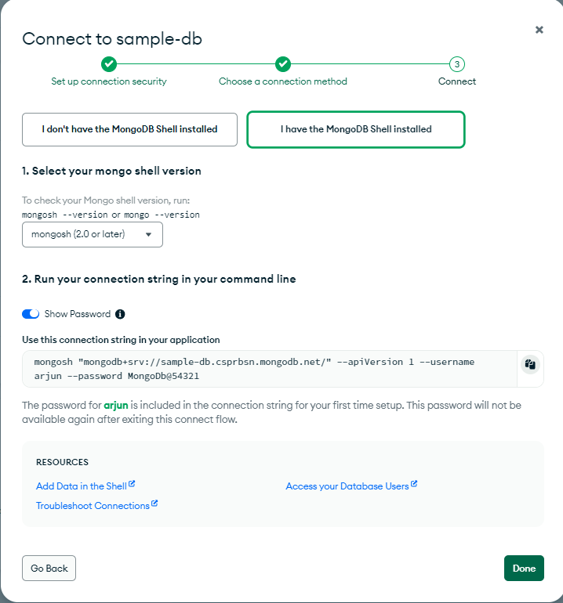

Slide 32
Interact with Atlas Cluster
With
Mongo Shell
Compass
VS Code
Python code

Slide 33
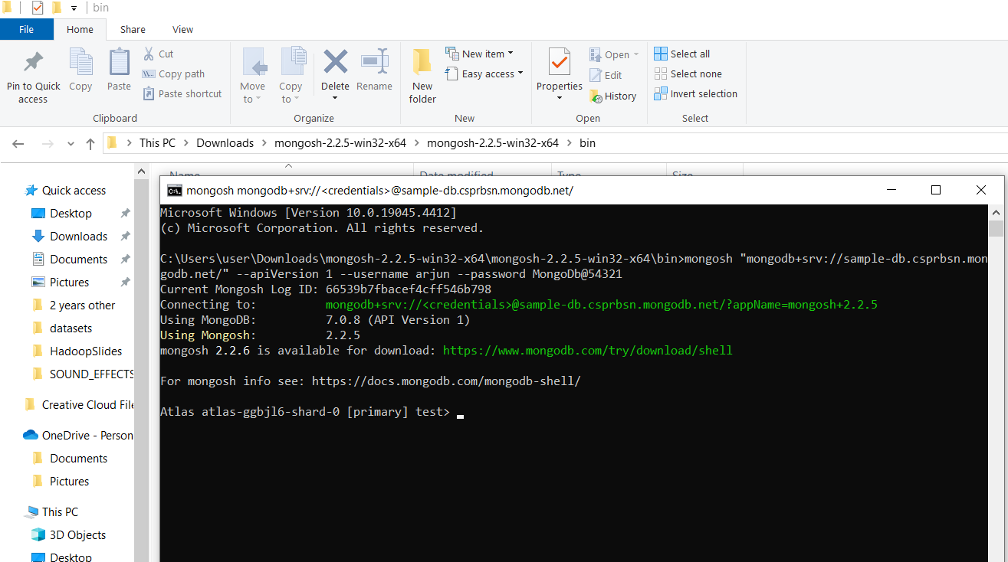

Slide 34
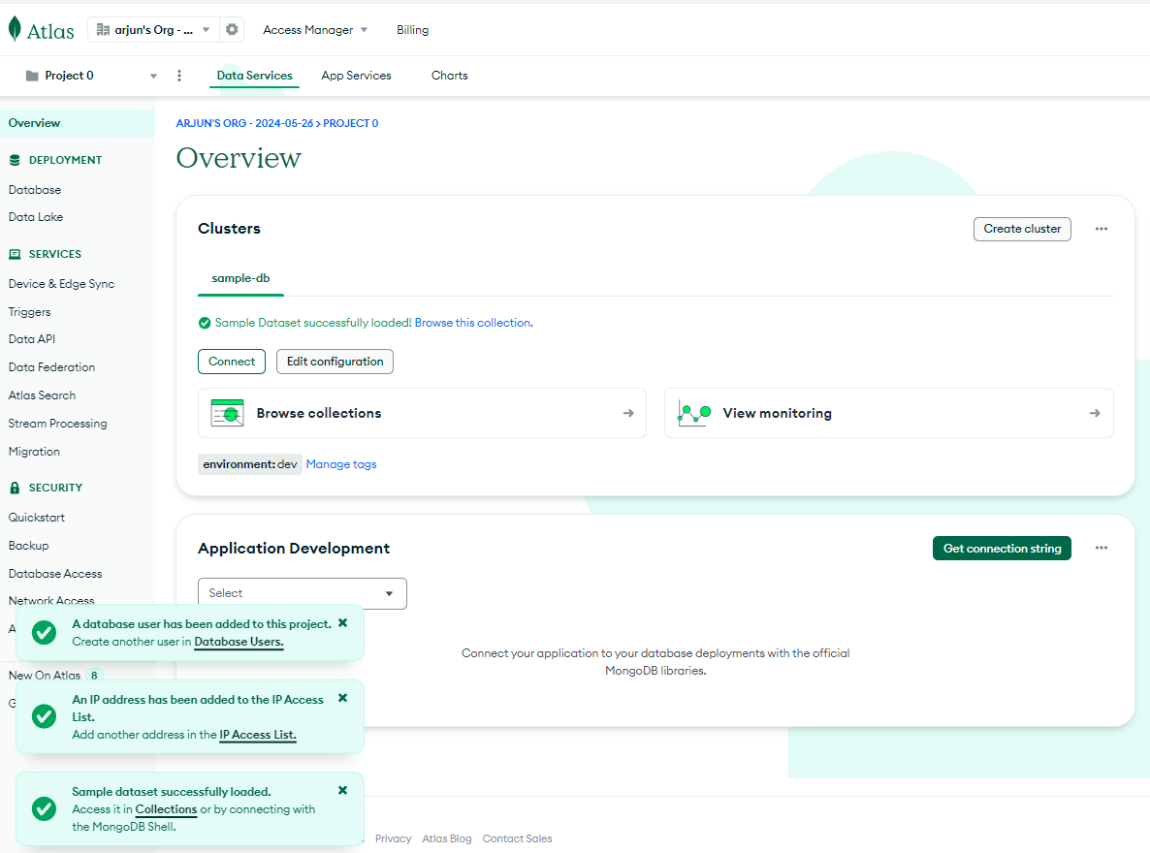

Slide 35
schema and model design
In MongoDB, schema and model design involve structuring your data in a way that optimizes query performance, facilitates data manipulation, and meets the requirements of your application

Slide 36
Schema Design
Unlike traditional relational databases, MongoDB is schema-less, meaning documents in a collection do not need to adhere to a predefined schema.
However, having a well-defined schema can still be beneficial for organizing and managing your data effectively.
Schema design in MongoDB involves defining the structure of your documents, including the fields and their data types.
Consider your application's data access patterns, query requirements, and performance goals when designing your schema.
Determine the relationships between entities and how they should be represented in your data model.

Slide 37
Model Design
Model design in MongoDB involves creating models or representations of your data entities in your application code.
In many MongoDB applications, the model design is closely related to the schema design, with each model representing a document type in the database.
Models encapsulate the logic for interacting with MongoDB, including CRUD operations, data validation, and business logic.
Use an Object-Document Mapper (ODM) or Object-Relational Mapper (ORM) library, such as Mongoose for Node.js, to define and work with models in your application.
Define methods and statics on your models to encapsulate common data manipulation tasks and enforce business rules.

Slide 38
Model Design
import mongoengine as db
# Connect to MongoB
db.connect("sample_db")
# Define a MongoDB document schema using mongoengine
class Product(db.Document):
name = db.StringField(required=True)
category = db.StringField(required=True)
price = db.FloatField(required=True)
stock = db.IntField(required=True)

Slide 39
Best Practices for Schema and Model Design
Denormalize data where appropriate to optimize query performance and reduce the need for expensive joins.
Embed related data within documents to improve query efficiency and reduce the number of database operations.
Use references or manual references (referring to documents by their ObjectId) for representing relationships between entities when embedding is not feasible.
Avoid deep nesting of documents to prevent document growth and improve query performance.
Optimize your schema for the most frequent and critical query patterns of your application.
Consider the read and write scalability requirements of your application when designing your schema and models.
Regularly review and iterate on your schema and model design as your application evolves and your data requirements change.

Slide 40
Indexing strategy
Indexes in MongoDB are special data structures that store a small portion of the data set in an easy-to-traverse form. Indexes support the efficient execution of queries.
Without indexes, MongoDB must perform a collection scan, which examines every document in a collection to select those documents that match the query statement.

Slide 41
Indexing strategy
Single Field Index:
Indexes on a single field.
db.collection.createIndex({ field: 1 })
db.products.createIndex({ "attributes.brand": 1 });
Compound Index:
Indexes on multiple fields.
db.collection.createIndex({ field1: 1, field2: -1 })
db.products.createIndex({ category: 1, price: -1 });

Slide 42
Indexing strategy
Multikey Index:
Indexes on array fields. MongoDB creates separate index entries for each element of the array.
db.collection.createIndex({ arrayField: 1 })
Geospatial Indexes: Indexes for geospatial queries.
db.collection.createIndex({ location: "2dsphere" })

Slide 43
Indexing strategy
Text Indexes: Indexes for text search.
db.collection.createIndex({ field: "text" })
Hashed Indexes: Indexes that hash the value of the indexed field. Suitable for sharding.
db.collection.createIndex({ field: "hashed" })

Slide 44
Indexing strategy
To list all indexes on a collection
db.products.getIndexes();
To remove an index.
db.products.dropIndex("indexName");

Slide 45
optimize mongodb queries
Optimizing MongoDB queries involves various strategies aimed at improving query performance, reducing execution time, and enhancing overall database efficiency
Use Indexes:
Indexes can significantly improve query performance by allowing MongoDB to quickly locate relevant documents. Analyze your query patterns and create appropriate indexes on the fields used in query predicates. Use the createIndex() method to create indexes.
Covered Queries:
Ensure that queries can be satisfied using index keys only, without needing to examine the actual documents. Covered queries can be significantly faster because MongoDB can retrieve results directly from the index. This reduces the need for disk I/O and can improve performance.

Slide 46
optimize mongodb queries
Query Patterns:
Review your query patterns and optimize them where possible. Avoid using inefficient operators or query patterns. For example, rewrite $or queries with multiple predicates using other operators like $in or $and.
Query Projection:
Use projection to limit the fields returned by the query to only those needed by the application. This reduces the amount of data transferred over the network and can improve query performance, especially for queries that return large documents.

Slide 47
optimize mongodb queries
Batch Processing:
Use batch processing techniques to process large amounts of data efficiently. Instead of retrieving all documents at once, use pagination or batch processing with limits and offsets to retrieve data in smaller chunks.
Aggregation Pipeline:
Utilize the MongoDB aggregation framework for complex data processing tasks. Aggregation pipelines allow you to perform operations like filtering, grouping, sorting, and aggregating data in a highly efficient manner.

Slide 48
optimize mongodb queries
Query Profiling:
Enable query profiling to identify slow-running queries and analyze their execution plans. Use the db.setProfilingLevel() command to enable profiling and set the threshold for slow queries. Analyze the output of the profiling data to identify bottlenecks and areas for optimization.
Server Configuration:
Review and adjust MongoDB server configuration parameters based on your workload and hardware resources. Adjust parameters such as storage.engine, index.buildThreads, wiredTigerCacheSizeGB, etc., to optimize server performance.

Slide 49
optimize mongodb queries
Schema Design:
Design your schema to optimize query performance. Use embedded documents and arrays where appropriate to reduce the number of database operations needed to retrieve related data. Denormalize data when necessary to improve read performance.
Sharding:
Consider sharding your MongoDB cluster to distribute data across multiple shards and improve scalability and performance. Sharding allows you to horizontally scale your database by partitioning data across multiple servers.

Slide 50
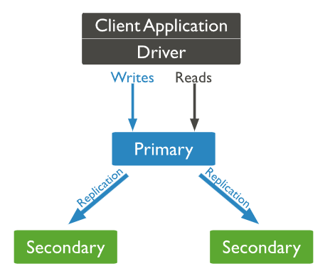
Replication
MongoDB replication provides redundancy and increases data availability by distributing data across multiple servers.
This ensures that even if one server fails, the data remains accessible through other servers in the replica set

Slide 51
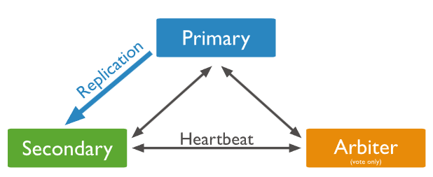
Replication
Replica Set:
A group of mongod instances that maintain the same dataset. A replica set consists of:
Primary: Receives all write operations.
Secondaries: Replicate the primary’s oplog and apply the operations to their datasets.
Arbiters (optional): Participate in elections but do not hold data.

Slide 52
How Replication Works
Oplog (Operations Log):
A special capped collection that records all changes to the data. The oplog is used to replicate operations from the primary to the secondaries.
Initial Sync:
When a secondary node first joins a replica set, it performs an initial sync by copying all data from the primary node to ensure its dataset is up-to-date.
This involves copying all the collections and their indexes and then applying all the changes that occurred during the copy process.

Slide 53
How Replication Works
Replication Process:
Writes to Primary: Clients send write operations to the primary node.
Oplog Recording: The primary node records each write operation in its oplog.
Replication to Secondaries: Secondary nodes continuously replicate the oplog entries from the primary node.
Applying Oplog Entries: Secondary nodes apply the operations from the primary’s oplog to their datasets to keep in sync.

Slide 54
How Replication Works
Replication Lag:
The delay between the time an operation is executed on the primary and the time it is applied on a secondary. Minimizing replication lag is crucial for maintaining up-to-date secondaries.
Arbiters: If configured, arbiters can vote in elections but do not store data.

Slide 55
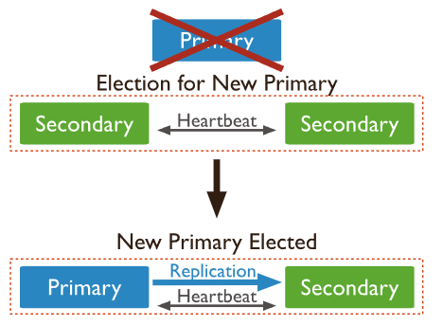
How Replication Works
Elections:
Primary Failure: If the primary node becomes unavailable, an election is triggered to choose a new primary from the secondaries.
Election Process: Each node votes to select a new primary based on various factors like node priority, election timeout, and network connectivity.

Slide 56
Benefits of Replication
High Availability: Automatic failover in case of primary failure ensures minimal downtime.
Data Redundancy: Copies of the data on multiple nodes protect against data loss.
Read Scalability: Read operations can be distributed across secondary nodes, reducing the load on the primary.

Slide 57
Setting Up the Replica Set
mongod --replSet rs0 --port 27017 --dbpath ~/mongo/rs0 --bind_ip localhost --logpath ~/mongo/rs0/mongod.log
mongod --replSet rs0 --port 27018 --dbpath ~/mongo/rs1 --bind_ip localhost --logpath ~/mongo/rs1/mongod.log
mongod --replSet rs0 --port 27019 --dbpath ~/mongo/rs2 --bind_ip localhost --logpath ~/mongo/rs2/mongod.log

Slide 58
Initialize the Replica Set
mongosh --port 27017
rs.initiate({
_id: "rs0",
members: [
{ _id: 0, host: "localhost:27017" },
{ _id: 1, host: "localhost:27018" },
{ _id: 2, host: "localhost:27019" }
]
})

Slide 59
Monitor Replica Set
rs.status()
mongosh --port 27017
use testDB
db.testCollection.insert({ name: "testDocument" })
# Open in another terminal to validate the data
mongosh --port 27018
use testDB
rs.slaveOk() // Allows reading from the secondary node
db.testCollection.find()
mongosh --port 27019
use testDB
rs.slaveOk() // Allows reading from the secondary node
db.testCollection.find()

Slide 60
Replica Set Operations
Initializing a Replica Set:
rs.initiate(): Initialize a replica set.
Checking Replica Set Status:
rs.status(): Display the current status of the replica set.
Adding a Member to the Replica Set:
rs.add("hostname:port"): Add a new member to the replica set.
Removing a Member from the Replica Set:
rs.remove("hostname:port"): Remove a member from the replica set.

Slide 61
MongoDB configuration file
The MongoDB configuration file, typically named mongod.conf for the mongod (MongoDB daemon) process, is used to configure various settings for a MongoDB instance. This file can be written in YAML or JSON format.
File location
MAC: /usr/local/etc/mongod.conf
Windows: C:\Program Files\MongoDB\Server\<version>\bin\mongod.cfg
Linux: /etc/mongod.conf

Slide 62
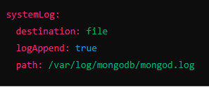
Structure of mongod.conf
systemLog: Configures the logging options.
destination: Specifies where the logs are stored (file, syslog, etc.).
logAppend: If true, appends new entries to the log file instead of overwriting.
path: Specifies the path to the log file.

Slide 63
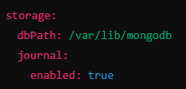
Structure of mongod.conf
storage: Configures storage-related options.
dbPath: Path to the directory where MongoDB stores its data.
journal: Settings related to journaling, which helps ensure data durability.
enabled: Whether journaling is enabled.

Slide 64

Structure of mongod.conf
net: Network settings.
port: Port number on which MongoDB listens for connections.
bindIp: IP addresses to bind to and listen for connections.

Slide 65


Structure of mongod.conf
security: Security settings.
authorization: If set to enabled, enforces user access control.
operationProfiling: Controls operation profiling, which can log slow queries.
mode: Profiling mode (off, slowOp, all).
slowOpThresholdMs: Threshold for slow operations in milliseconds.

Slide 66


Structure of mongod.conf
replication: Configuration for replica sets.
replSetName: Name of the replica set.
sharding: Sharding configuration.
clusterRole: Defines the role of the MongoDB instance in a sharded cluster (configsvr, shardsvr).

Slide 67


Structure of mongod.conf
processManagement: Options for managing the MongoDB process.
fork: If true, runs MongoDB as a daemon (background process).
pidFilePath: Path to the file that stores the process ID.
setParameter: Sets various runtime parameters.
You can specify various internal parameters, such as enabling the in-memory storage engine, changing timeout settings, etc

Slide 68
mongod
Basic mongod Start Command:
mongod
Start mongod with a Specific Configuration File:
mongod --config /etc/mongod.conf
Start mongod with Authentication Enabled:
mongod --auth

Slide 69
mongod
Start mongod and Specify Data Directory:
mongod --dbpath /data/db
Start mongod as a Daemon (Background Process):
mongod --fork --logpath /var/log/mongodb/mongod.log
Start mongod on a Custom Port:
mongod --port 27018
Set a Runtime Parameter for mongod:
mongod --setParameter enableLocalhostAuthBypass=false

Slide 70
mongod
Start mongod as Part of a Replica Set:
mongod --replSet rs0
Start mongod as a Shard Server:
mongod --shardsvr
Enable Journaling for mongod:
mongod --journal
Journaling ensures data durability by recording write operations in a journal before applying them to data files.

Slide 71
Backup
Using mongodump and mongorestore
mongodump and mongorestore are command-line utilities provided by MongoDB for backing up and restoring databases.
Backup with mongodump
To back up a MongoDB database, you can use the mongodump command. Open your terminal or command prompt and run:

Slide 72
Backup
mongodump --db yourDatabaseName --out /path/to/backup/directory
--db yourDatabaseName:
Specifies the name of the database you want to back up.
--out /path/to/backup/directory:
Specifies the directory where you want the backup files to be stored.
#All database
mongodump --out /path/to/backup/directory

Slide 73
Backup
Restore with mongorestore
To restore a MongoDB database from a backup, use the mongorestore command:
mongorestore --db yourDatabaseName /path/to/backup/directory/yourDatabaseName
--db yourDatabaseName: Specifies the name of the database you want to restore.
/path/to/backup/directory/yourDatabaseName: Specifies the path to the backup directory containing the dump files for the database.

Slide 74
Automate Backups
#!/bin/bash
# Set the current date and time
TIMESTAMP=$(date +"%Y%m%d%H%M")
# Define the backup directory
BACKUP_DIR="/path/to/backup/directory/$TIMESTAMP"
# Create the backup directory
mkdir -p $BACKUP_DIR
# Run mongodump
mongodump --db yourDatabaseName --out $BACKUP_DIR
# (Optional) Remove old backups, keep last 7 backups for example
find /path/to/backup/directory/* -mtime +7 -exec rm -rf {} \;

Slide 75
Scalability
Scalability in MongoDB refers to the ability of the database system to handle increasing amounts of data, workload, and users while maintaining performance, availability, and reliability.
MongoDB offers horizontal scalability, which means that you can scale out your MongoDB deployment by adding more servers (nodes) to distribute the workload and data across multiple machines

Slide 76
Vertical Scaling
Vertical scaling, also known as scaling up, involves increasing the capacity of a single server by adding more resources such as CPU, memory, or storage. In the context of MongoDB, vertical scaling typically involves upgrading the hardware resources of a single MongoDB instance.
For example:
Increasing CPU power by upgrading to a faster processor.
Adding more RAM to handle larger datasets and improve query performance.
Upgrading to faster storage devices (e.g., SSDs) to reduce latency and improve I/O performance.
Vertical scaling has its limitations, as there's a limit to how much you can scale up a single server. Eventually, you may reach the maximum capacity of the hardware, and further upgrades become impractical or prohibitively expensive.

Slide 77
Horizontal Scaling
Horizontal scaling, also known as scaling out, involves distributing the workload and data across multiple servers (nodes) in a cluster.
Horizontal scaling is achieved through sharding, which partitions data across multiple machines.
Each shard (server) holds a subset of the data, allowing the cluster to handle larger datasets and higher workloads.

Slide 78
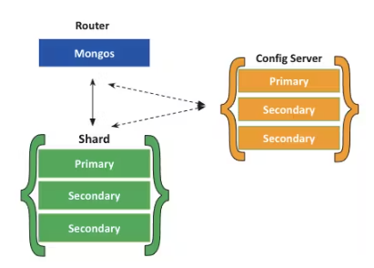
Sharding
Sharding in MongoDB is a data partitioning technique used to horizontally scale out the database across multiple machines (shards).
Sharding allows MongoDB to handle large datasets and high throughput by distributing data and workload across multiple servers.

Slide 79
Key Concepts
Shard:
A shard is a single MongoDB instance or server that holds a portion of the data. Shards collectively store the entire dataset in a sharded cluster.

Slide 80
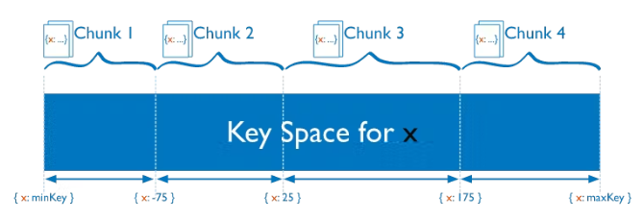
Key Concepts
Shard Key:
The shard key is a field in the documents that MongoDB uses to partition data across shards. MongoDB routes queries based on the shard key to the appropriate shard(s).

Slide 81
Key Concepts
Config Servers:
Config servers store metadata about sharded data, such as which data belongs to which shard. MongoDB uses config servers to route queries and manage the sharded cluster.
mongos:
The mongos process acts as a query router in a sharded cluster. Clients connect to mongos instances, which route queries to the appropriate shards based on the shard key.

Slide 82
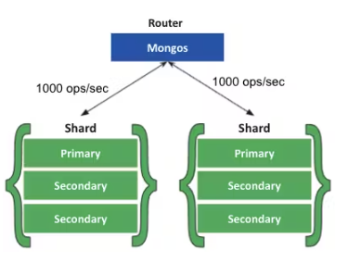
Sharding Benefits
Increased read/write throughput:
You can take advantage of parallelism by distributing the data set across multiple shards.
Let’s say one shard can process one thousand operations per second.
For each additional shard, you would gain an additional one thousand operations per second in throughput.

Slide 83
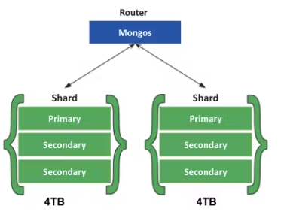
Sharding Benefits
Increased storage capacity:
Similarly, by increasing the number of shards, you can also increase overall total storage capacity.
Let’s say one shard can hold 4TB of data.
Each additional would increase your total storage by 4TB. This allows near-infinite storage capacity.

Slide 84
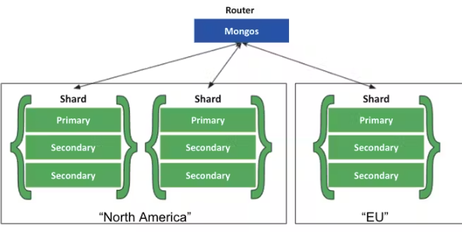
Sharding Benefits
Data Locality:
Zone Sharding allows you to easily create distributed databases to support geographically distributed apps, with policies enforcing data residency within specific regions.
Each zone can have one or more shards.

Slide 85
Sharding Process
Choosing a Shard Key:
The first step in sharding is selecting an appropriate shard key. The shard key should distribute data evenly across shards and support the most common query patterns.
Enabling Sharding for a Database:
Before sharding a collection, you need to enable sharding for the database that contains the collection. You can do this using the sh.enableSharding("<database_name>") command.

Slide 86
Sharding Process
Sharding a Collection:
Once sharding is enabled for the database, you can shard a collection by specifying the shard key. Use the sh.shardCollection("<database_name>.<collection_name>", { <shard_key> }) command to shard the collection based on the chosen shard key.
Data Distribution:
MongoDB automatically splits data into chunks and distributes them across shards based on the shard key. Each shard is responsible for storing a subset of the data.

Slide 87
Sharding Process
Query Routing:
Clients connect to mongos instances, which act as query routers in the sharded cluster. mongos routes queries to the appropriate shards based on the shard key specified in the query.
Balancing Data:
MongoDB continuously monitors data distribution across shards and automatically balances data chunks to ensure even distribution. If a shard becomes overloaded or underutilized, MongoDB redistributes data to rebalance the cluster.

Slide 88
Sharding Operations
Enabling Sharding for a Database:
sh.enableSharding("database_name"): Enable sharding for a specific database.
Sharding a Collection:
sh.shardCollection("database_name.collection_name", {shard_key}): Shard a collection based on a shard key.
Checking Sharding Status:
sh.status(): Display the status of the sharded cluster.

Slide 89
Setup Shard
Start Config Server
mongod --port 27020 --dbpath /data/config1 --configsvr --replSet configReplSet
mongod --port 27021 --dbpath /data/config2 --configsvr --replSet configReplSet
mongod --port 27022 --dbpath /data/config3 --configsvr --replSet configReplSet

Slide 90
Setup Shard
Initiate Config Server Replica Set: Connect to one of the config servers and initiate the replica set:
mongo --port 27020
rs.initiate({
_id: "configReplSet",
configsvr: true,
members: [
{ _id: 0, host: "localhost:27020" },
{ _id: 1, host: "localhost:27021" },
{ _id: 2, host: "localhost:27022" }
]
})

Slide 91
Setup Shard
Enable Sharding: Connect to any one of the MongoDB instances from the replica set and enable sharding for the database you want to shard:
mongo --port 27017
use admin
db.runCommand({ enableSharding: "your_database_name" })

Slide 92
Setup Shard
Add Shards: Add the replica set as a
shardsh.addShard("rs0/localhost:27017,localhost:27018,localhost:27019")

Slide 93
Setup Shard
Write python code to insert sample data
https://github.com/arjunachari12/mongodb-learn-basic/blob/main/day4/sample-data.py
#in the mongo shell
sh.shardCollection("my_database.orders", { "customer_id": 1 })

Slide 94
security in MongoDB
Authentication:
MongoDB supports various authentication mechanisms like SCRAM, x.509 certificates, LDAP, and Kerberos, ensuring only authorized users can access the database.
Authorization:
Once authenticated, MongoDB employs role-based access control (RBAC) to determine the actions users can perform and the data they can access. Roles can be predefined or custom, granting privileges at the database or collection level.

Slide 95
security in MongoDB
Encryption:
MongoDB offers encryption at rest and in transit. Data at rest can be encrypted using WiredTiger encryption, while data in transit can be secured using TLS/SSL encryption, preventing eavesdropping and tampering.
Auditing:
MongoDB Enterprise provides auditing capabilities to track user actions and system events. Audit logs can be configured to capture operations like authentication, authorization, and database management actions, aiding in compliance and forensic analysis.

Slide 96
security in MongoDB
Network Security:
MongoDB can be configured to bind to specific network interfaces and IP addresses, limiting exposure to potential threats. Additionally, firewall rules can be applied to control access to MongoDB instances.
Updates and Patches:
Regular updates and patches are crucial to address security vulnerabilities and protect against known threats. MongoDB provides timely updates and security advisories to help users keep their deployments secure.

Slide 97
Authentication
SCRAM (Salted Challenge Response Authentication Mechanism):
SCRAM is the default authentication mechanism in MongoDB.
It provides a secure way to authenticate users by hashing their passwords and exchanging challenge-response messages with the server.
SCRAM ensures that passwords are never sent over the network in plain text, enhancing security.
User credentials are stored in the system.users collection within the admin database by default.

Slide 98
Authentication
x.509 Certificate Authentication:
LDAP (Lightweight Directory Access Protocol) Authentication:
Kerberos Authentication:
Client Certificate Authentication:

Slide 99
Create User
use admin
db.createUser({
user: "admin",
pwd: "adminpassword",
roles: [{ role: "userAdminAnyDatabase", db: "admin" }]
})

Slide 100
Create User
mongod --auth --dbpath /path/to/your/db --bind_ip 127.0.0.1
mongosh -u "admin" -p "adminpassword" --authenticationDatabase "admin"

Slide 101
Create additional user
use yourdatabase
db.createUser({
user: "appuser",
pwd: "apppassword",
roles: [{ role: "readWrite", db: "yourdatabase" }]
})
mongosh -u "appuser" -p "apppassword" --authenticationDatabase "yourdatabase"

Slide 102
Authorization
View Roles Assigned to a User
use admin
db.getUser("username")
View All Roles in a Database:
use yourdatabase
db.getRoles({ showPrivileges: true, showBuiltinRoles: true });

Slide 103
Adding Roles to a User
mongosh -u "admin" -p "adminpassword" --authenticationDatabase "admin"
use admin
db.updateUser("username", {
roles: [
{ role: "readWrite", db: "yourdatabase" },
{ role: "anotherRole", db: "anotherdatabase" } // Optional: Add more roles
]
})

Slide 104
Monitoring
Monitoring in MongoDB involves tracking the performance and health of your MongoDB deployment to ensure that it is running optimally and to quickly identify and resolve any issues that arise.

Slide 105
Key Metrics to Monitor
Operation Metrics:
Query Performance: Track query execution times and the number of queries per second.
Write Performance: Monitor insert, update, delete operations per second.
Locks: Monitor lock times and lock percentages to detect contention issues.
System Metrics:
CPU Usage: Ensure that the CPU usage is within acceptable limits.
Memory Usage: Monitor the amount of memory used by MongoDB and the operating system.
Disk I/O: Track read and write operations to detect disk bottlenecks.

Slide 106
Key Metrics to Monitor
Replica Set Metrics:
Replication Lag: Measure the time it takes for write operations to replicate to secondary nodes.
Election Events: Monitor events related to primary elections in the replica set.
Storage Metrics:
Data Size: Track the size of your data and indexes.
Index Performance: Monitor the performance of indexes to ensure they are being used efficiently.

Slide 107
Tools for Monitoring MongoDB
MongoDB Atlas:
A cloud-based database service that includes built-in monitoring and alerting.
Provides a dashboard with real-time and historical metrics.
Allows you to set custom alerts for various metrics.
MongoDB Cloud Manager:
A monitoring and backup solution for MongoDB deployments, available both on-premises and in the cloud.
Offers visualization, alerting, and backup management.

Slide 108
Tools for Monitoring MongoDB
MongoDB Ops Manager:
An on-premises solution for managing, monitoring, and backing up MongoDB deployments.
Provides similar functionality to MongoDB Cloud Manager but for on-premises environments.
mongostat and mongotop:
Command-line tools provided with MongoDB.
mongostat: Provides a quick overview of the status of a MongoDB instance.
mongotop: Displays the amount of time MongoDB spends reading and writing data.

Slide 109
Third-Party Monitoring Tools
Prometheus: An open-source monitoring and alerting toolkit that can be used with MongoDB exporters.
Grafana: A popular open-source analytics and monitoring platform that integrates well with Prometheus.
Datadog: A monitoring service that can monitor MongoDB metrics and integrate with various other services.

Slide 110
Built-in Monitoring Commands
db.stats(): Provides statistics about the database.
db.serverStatus(): Offers detailed information about the server's status.
rs.status(): Displays the status of the replica set.

Slide 111
Commands
mongostat --port 27017
mongotop

Slide 112
auditing in the MongoDB
Change config file
auditLog:
destination: file
path: /var/log/mongodb/audit.log
format: JSON
sudo service mongod restart

Slide 113
Migrate data from MongoDB to atlas
Export Data from Local MongoDB (mongodump):
mongodump --uri="mongodb://localhost:27017/mydatabase" --out="backup_directory"
Import Data into MongoDB Atlas (mongorestore)
mongorestore --uri="mongodb+srv://<username>:<password>@<cluster>/<database>" --drop "backup_directory"
mongoimport --uri "mongodb://root:<PASSWORD>@atlas-host1:27017,atlas-host2:27017,atlas-host3:27017/<DATABASE>?ssl=true&replicaSet=myAtlasRS&authSource=admin" --collection myData --drop --file /somedir/myFileToImport.json

Slide 114
Migration tools
Live Migration: MongoDB Atlas offers a Live Migration service that allows you to seamlessly migrate data from an existing MongoDB deployment to an Atlas cluster with minimal downtime.
MongoDB Atlas Data Transfer: MongoDB Atlas provides a Data Transfer service that enables you to securely transfer data between Atlas clusters and other MongoDB deployments.
MongoDB Atlas Import/Export: MongoDB Atlas offers built-in import and export functionality that allows you to import data from JSON, CSV, or BSON files into your Atlas cluster or export data from your Atlas cluster to these formats.

